Slide 1
LIBS 7001: Week 6(b)
© BCIT
Adapted from original slides by G.Homel and C.Liotta

Slide 2
Citing Sources
(SSW, Ch. 19-20)
“Citing sources”: using established formats & conventions for documenting others’ words and ideas
You must document any summary, paraphrase, or quotation, statistics or graphics used in your paper.
Exception: you don't have to cite . . .
  common knowledge (Thousands ski Whistler each year)
  your own conclusions
  facts found in many sources (year of J. Chretien’s birth)
  standard terms (DVD, CD, download)
    ** see exercises in SSW

Slide 3
Why Must I Cite Sources?
To strengthen your argument by presenting authoritative evidence
To give credit to the people whose information you are using
To provide easy access to research you use so readers can verify / read more
To avoid putting you (and your organization) in the illegal situation of violating intellectual property rights – a specific form of theft
To increase your credibility by using citation “language” that’s universal to scholars / researchers

Slide 4
Three Types of Plagiarism
(Hacker, 261)
(1) “failing to cite
    quotations and
    borrowed ideas,
(2) failing to enclose borrowed language in quotation marks,
(3) failing to put summaries and paraphrases in your own words.”
BCIT policy #5002 Student Regulations governs academic honesty

Slide 5
Why Do People Plagiarize?
(J. Rodgers* )
(1) deliberate attempt to pass off another’s ideas as one’s own.
(2) ignorance of why and how to cite
(3) sloppiness, laziness -- failure to keep a record while researching
(4) “cryptomnesia” -- a forgetting of the source of one’s ideas, thinking them original
Reasons 2-4 do not justify plagiarism.
* J. Rodgers, “Why and How People Commit Plagiarism.” http://condor.bcm.tmc.edu/Micro-Immuno/courses/igr/whyplag.html(May 9, 1999)

Slide 6
Avoiding Plagiarism
(SSW, Ch. 19-20, Hacker, 262 ff.)
Cite quotations and borrowed ideas.
  includes direct quotes, paraphrases of sentences, chapters, paragraphs, diagrams, stats, tables.
  exception: common knowledge (e.g., Freud’s theory of the unconscious)
Enclose borrowed language in quotation marks.
  omitting quotation marks is plagiarism -- suggests that the words are your own
Put summaries and paraphrases in your own words.
  it’s plagiarism if you “half-copy” the author’s phrases without using quotation marks
** see exercises

Slide 7
Example: Borrowed Language
(Hacker)
Original source: No animal has done more to renew interest in animal intelligence than a beguiling, bilingual bonobo name Kanzi, who has the grammatical abilities of a 2 1/2-year-old child and a taste for movies about cavemen. (Eugene Linden, “Animals,” p. 57.)
Plagiarism: According to Eugene Linden, no animal has done more to renew interest in animal intelligence than a beguiling, bilingual bonobo name Kanzi, who has the grammatical abilities of a 2 1/2-year-old child and a taste for movies about cavemen.
Borrowed Language in Quotes: According to Eugene Linden, “No animal has done more to renew interest in animal intelligence than a beguiling, bilingual bonobo name Kanzi, who has the grammatical abilities of a 2 1/2-year-old child and a taste for movies about cavemen” (57).

Slide 8
Example: Summaries
(Hacker)
Original: If the existence of a signing ape was unsettling for linguists, it was also startling news for animal behaviorists. (Davis, Eloquent Animals, p. 26)
Unacceptable / borrowed phrases: The existence of a signing ape unsettled linguists and startled animal behaviorists.
Unacceptable / borrowed structure: If the presence of a sign-language-using chimp was disturbing for scientists studying language, it was also surprising to scientists studying animal behavior.
Acceptable: When they learned of an ape’s ability to use sign language, both linguists and animal behaviorists were taken by surprise.

Slide 9
Integrating Quotations
Use varied signal phrases, not “dropped quotations.”
    In the words of Gary Payton, ...
    According to broadcaster Cheryl Miller,...
    As Shaquille O’Neal has noted,
    “….”, claims linguist Noam Chomsky
Set off long quotations (>5 lines of prose, >3 lines of poetry): indent 10 spaces from the left.
Use an ellipsis mark “…” and brackets “[ ]”to show changes you make in a quote.

Slide 10
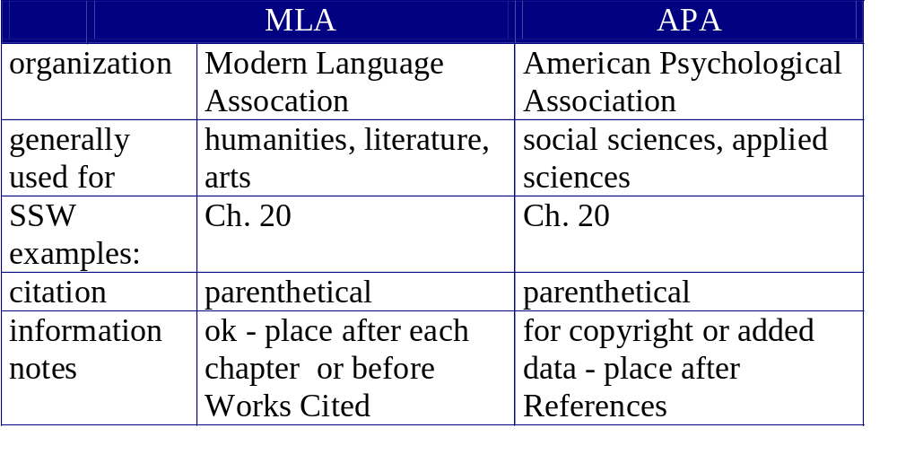
Two Systems of Documentation
(SSW)

Slide 11
Types of Citation
bibliography, works cited, references
  at the end of the text, listed alphabetically by author
  format varies between APA & MLA
parenthetical citation
  within the body of the text, listed in order of appearance or use
footnotes, endnotes
  superscript number appears in the text after quoted / borrowed material. ¹
  publication data for each note appears at bottom of each page (footnotes) or at the end of the entire text (endnotes).
A text with footnotes or endnotes also needs a reference section.

Slide 12
Parenthetical Citation
originated by APA; also now accepted by MLA & other styles of documentation
system of cross-reference between authors’ names / publication dates within the text, and an alphabetical list of references by author name / date.
virtually eliminates the need for footnotes / endnotes.
used with a signal phrase, which may or may not contain the author’s name (see SSW, p. 350).

Slide 13
Footnotes and Endnotes
(Hacker 327-32)
for each note, a superscript number appears in the text at the end of the sentence in which the source is quoted. ¹
the same superscript number, giving all publishing information, appears elsewhere in the document:
  footnotes: at bottom of the page
  endnotes: at the end of the paper, chapter, or article.
MLA and APA vary as to the placement of endnotes (before or after references / sources)
used in MLA; APA allows use only for copyright information or additional relevant data.

Slide 14
How to Cite & Take Notes
(adapted from John Rodgers*)
Before starting, clearly understand what constitutes plagiarism.
At the library or computer terminal
  always write down references in your notes
  always put quotes around a copied text
  note when you paraphrase: paraphrases need citations
  photocopy the front page of the source
  download and/print out electronic source material (CL)
  use your own initials to distinguish your comments from those of the text you’re reading (CL)
* John Rodgers, “Plagiary and the Art of Skillful Citation.” http://condor.bcm.tmc.edu/Micro-Immuno/courses/igr/artcite.html (May 9, 1999)

Slide 15
How to Cite & Take Notes, cont.
At the word processor / while composing
  (Brian Fiero): stay away from the primary source when composing, to avoid direct quotation or paraphrasing
  re-read your sentences and decide if they’re your own or if they need citations
Using @ref: when you’ve written something that needs a reference but you don’t have the original
  type “@ref” where you should place the reference
  later, search your document for “@ref” string, add the complete reference, and delete the “@ref.”

Slide 16
Common Citation Concerns
I've researched everything in the essay. I'll have to cite everything I wrote.
  No: your creativity and organization is shown in the material you select from other sources, and how you order and present that material. Most of the essay should be in your own words.
They (the outside sources) say it so much better than I can say it.
  But they're not writing on your specific topic.
  You have to select the information you need for your essay's purpose and audience, and quote selectively, but mainly use your own words.

Slide 17
Common Citation Concerns, cont.
I don't know when I'm paraphrasing, and when it would be considered my own words.
  Check with the APA Manual or MLA Style Guide in the library. When in doubt, make sure to include a citation.
Isn't everything on the Internet in the public domain?
  No; information on web sites, for example, is intellectual property, like hard-copy information.
  Even if the site allows use of the material, you still have to reference what you are using.

Slide 18
Common Citation Concerns, cont.
I put the source in parentheses in the essay; why do I have to list them in the references / bibliography too?
  The reader needs to know at all points in the essay what are your words/ideas, and what are those of others.
  Listing ALL sources at the end is convenient & important for the reader & lends credibility to your work.
What about this chart / photo / schematic from a book (or Internet)?
  Illustrations must be cited like other sources. Put the source in small type underneath the illustration, and ALSO list the source in the References section.

Slide 19
Common Citation Concerns, cont.
I can never remember the exact format for the different kinds of sources.
  Very few people remember the formats! Most people have to consult the reference books.
But this takes so much work; the essay is due tomorrow. Plan ahead and keep notes.
These are just theoretical requirements that students have to suffer through. Wrong. IP is a huge issue in “real life.”

Slide 20
1) general on-line orientation (including how to log in from home)
2) databases and indexes
3) scholarly (peer reviewed) versus non scholarly
4) York U Plagiarism site case studies
http://www.yorku.ca/tutorial/academic_integrity/

